Slide 1
PART TWO
“MODELING”

Slide 2
Chapter 04
“PRINCIPLES THAT GUIDE PRACTICE”
No Diagrams

Slide 3
Chapter 05
“UNDERSTANDING REQUIREMENTS”

Slide 4
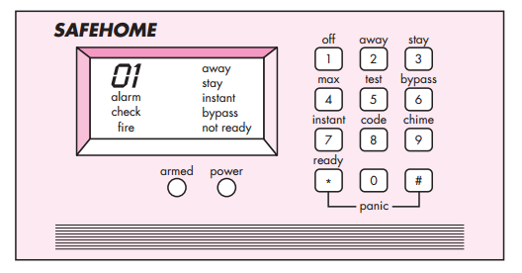
SafeHome control panel

Slide 5
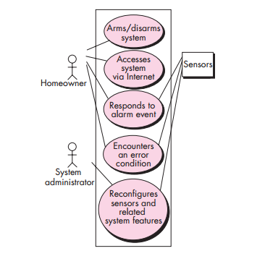
UML use case diagram for SafeHome home security function

Slide 6
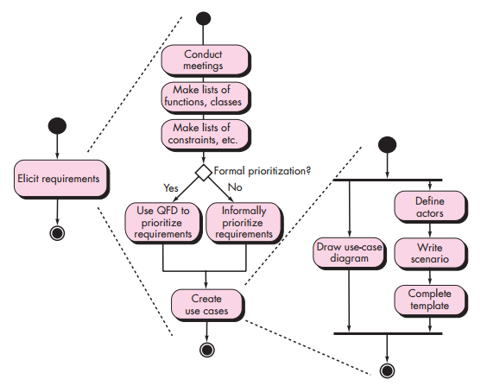
UML activity diagrams for eliciting requirements

Slide 7
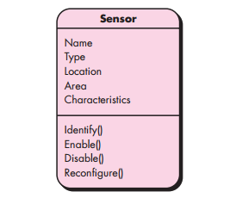
Class diagram for sensor

Slide 8
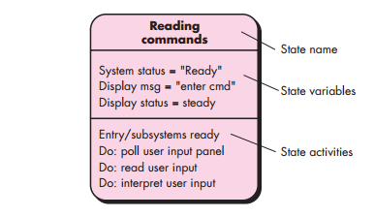
UML state diagram notation

Slide 9
Chapter 06
“REQUIREMENTS MODELING: SCENARIOS, INFORMATION, AND ANALYSIS CLASSES”

Slide 10
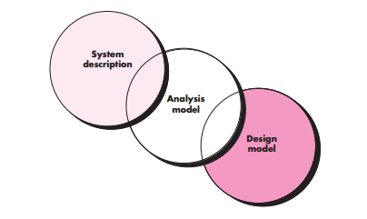
The requirements model as a bridge between the system description and the design model

Slide 11
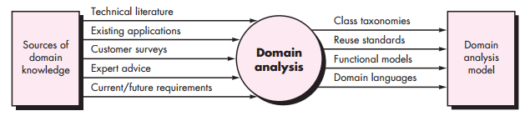
Input and output for domain analysis

Slide 12
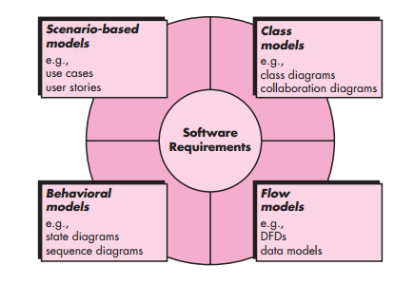
Elements of the analysis model

Slide 13
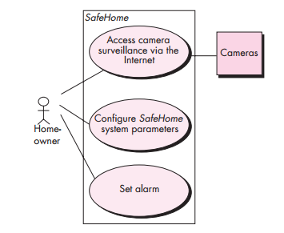
Preliminary use-case diagram for the SafeHome system

Slide 14
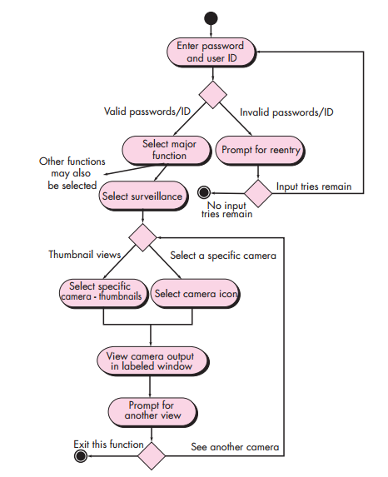
Activity diagram for Access camera surveillance via the Internet— display camera views function

Slide 15
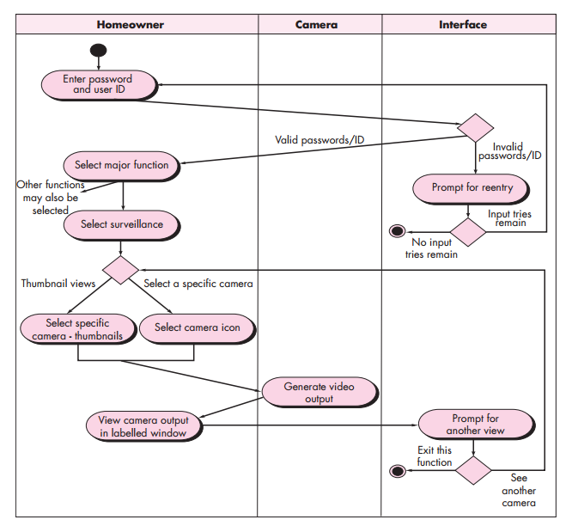
Swimlane diagram for Access camera surveillance via the Internet—display camera views function

Slide 16
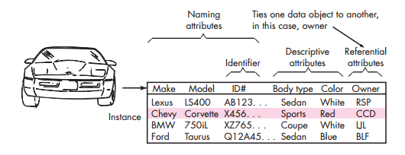
Tabular representation of data objects

Slide 17
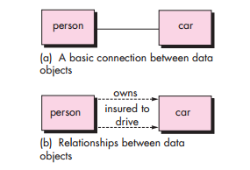
Relationships between data objects

Slide 18
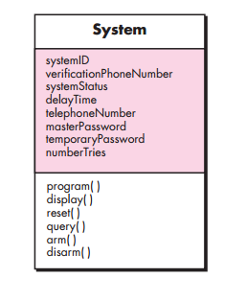
Class diagram for the system class

Slide 19
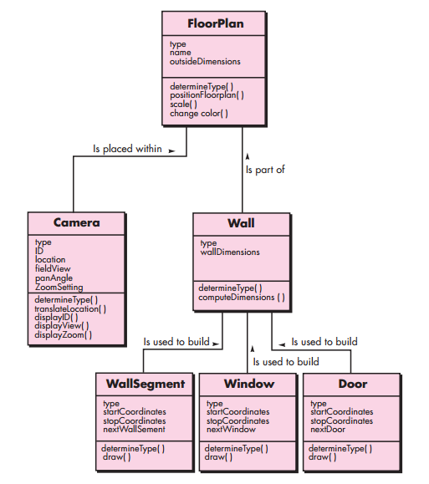
Class diagram for FloorPlan

Slide 20
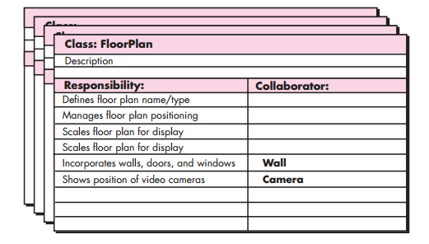
A CRC model index card

Slide 21
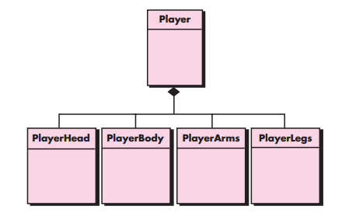
A composite aggregate class

Slide 22
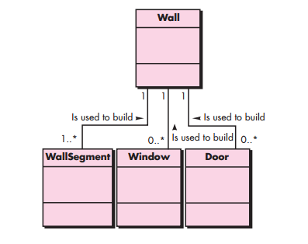
Multiplicity

Slide 23
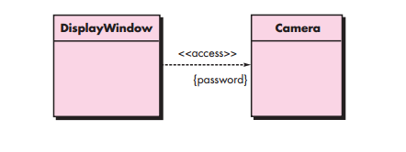
Dependencies

Slide 24
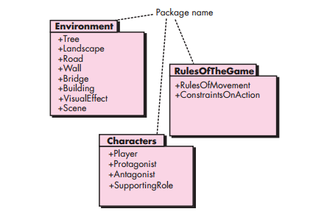
Packages

Slide 25
Chapter 07
“REQUIREMENTS MODELING: FLOW, BEHAVIOR, PATTERNS, AND WEBAPPS”
Notes:
<number>

Slide 26
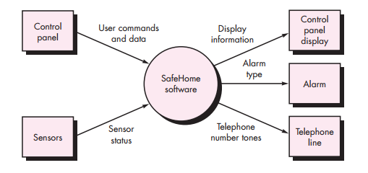
Context-level DFD for the SafeHome security function

Slide 27
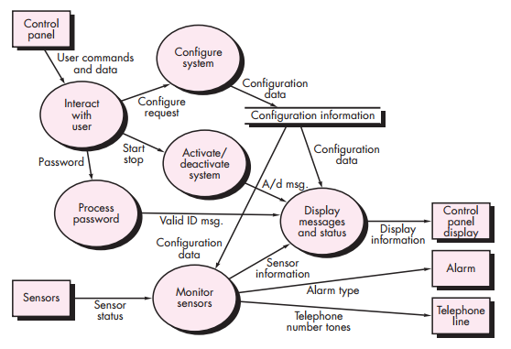
Level 1 DFD for SafeHome security function

Slide 28
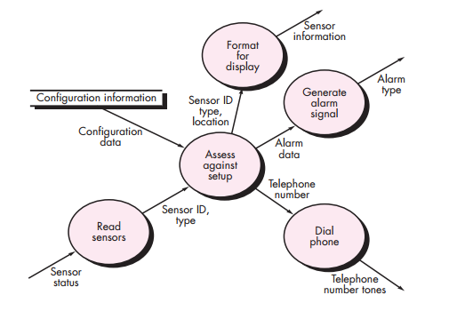
Level 2 DFD that refines the monitor sensors process

Slide 29
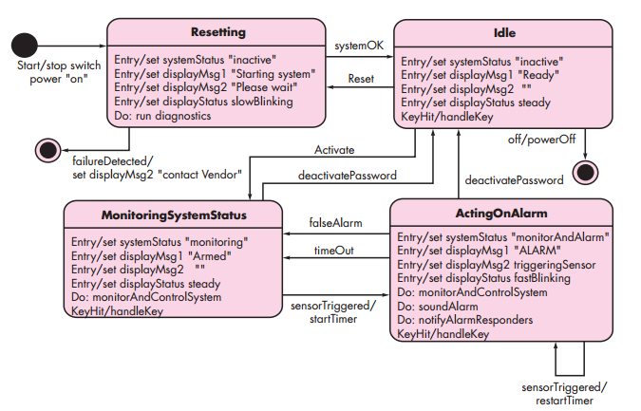
State diagram for SafeHome security function

Slide 30
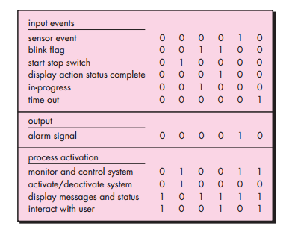
Process activation table for SafeHome security function

Slide 31
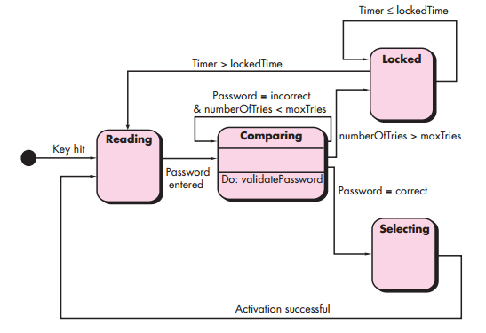
State diagram for the ControlPanel class
Notes:
<number>

Slide 32
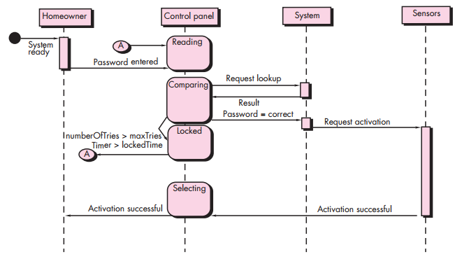
Sequence diagram (partial) for the SafeHome security function

Slide 33
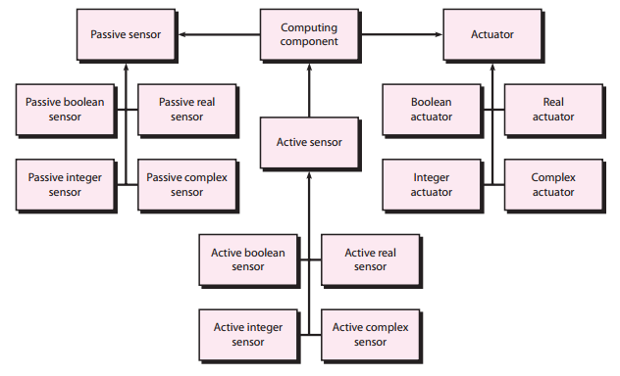
UML sequence diagram for the Actuator-Sensor pattern

Slide 34
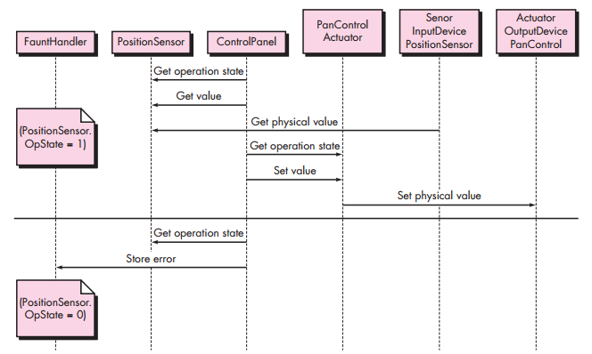
UML Class diagram for the Actuator-Sensor pattern

Slide 35
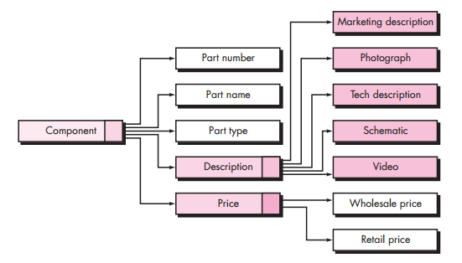
Data tree for a SafeHomeAssured.com component

Slide 36
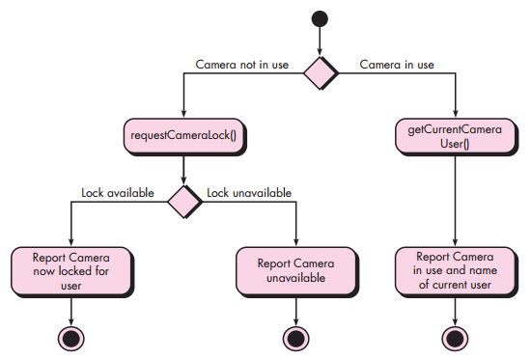
Activity diagram for the takeControlOfCamera() operation

Slide 37
Chapter 08
“DESIGN CONCEPTS”

Slide 38
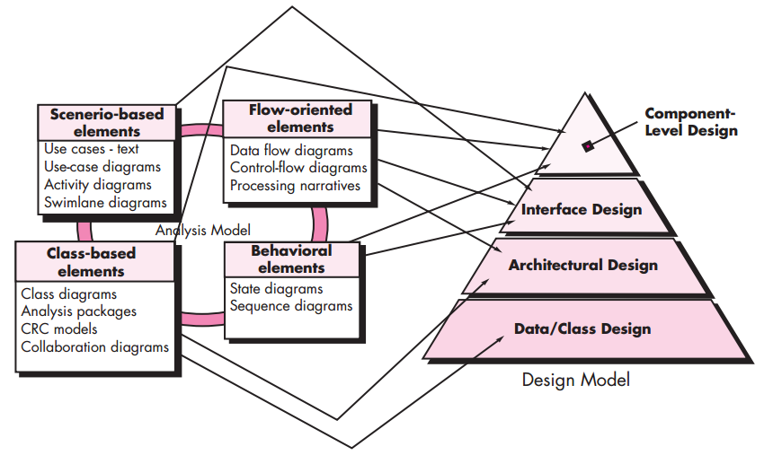
Translating the analysis model into the design model

Slide 39
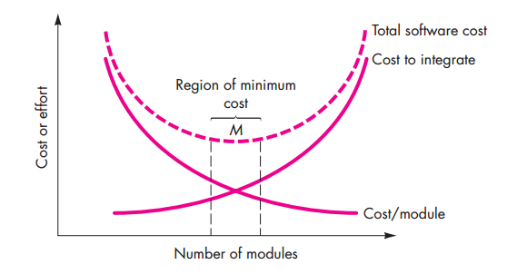
Modularity and software cost

Slide 40
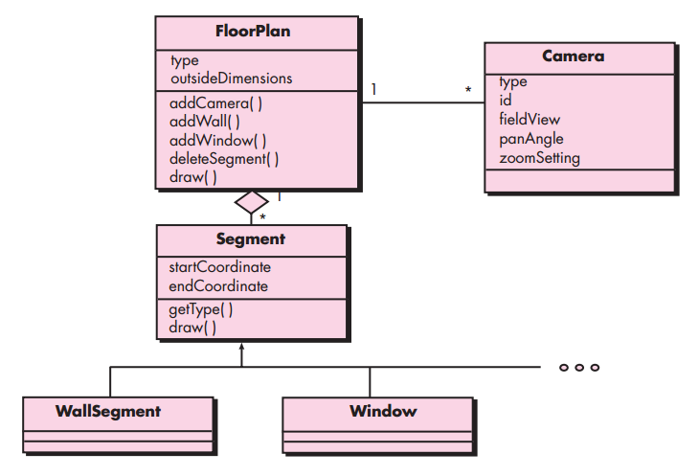
Design class for FloorPlan and composite aggregation for the class

Slide 41
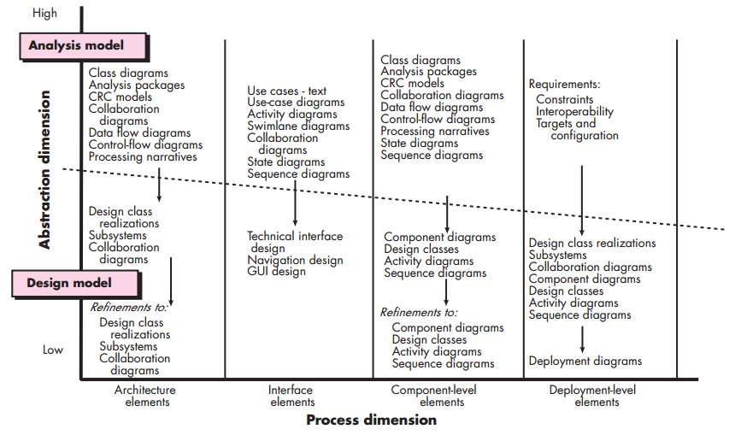
Dimensions of the design model

Slide 42
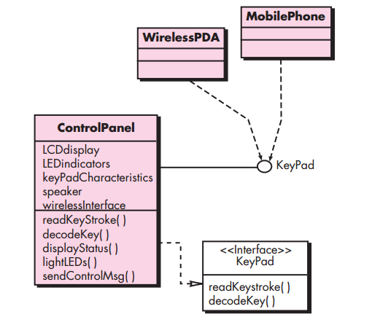
Interface representation for Control Panel

Slide 43
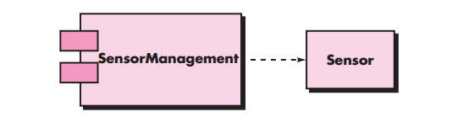
A UML component diagram

Slide 44
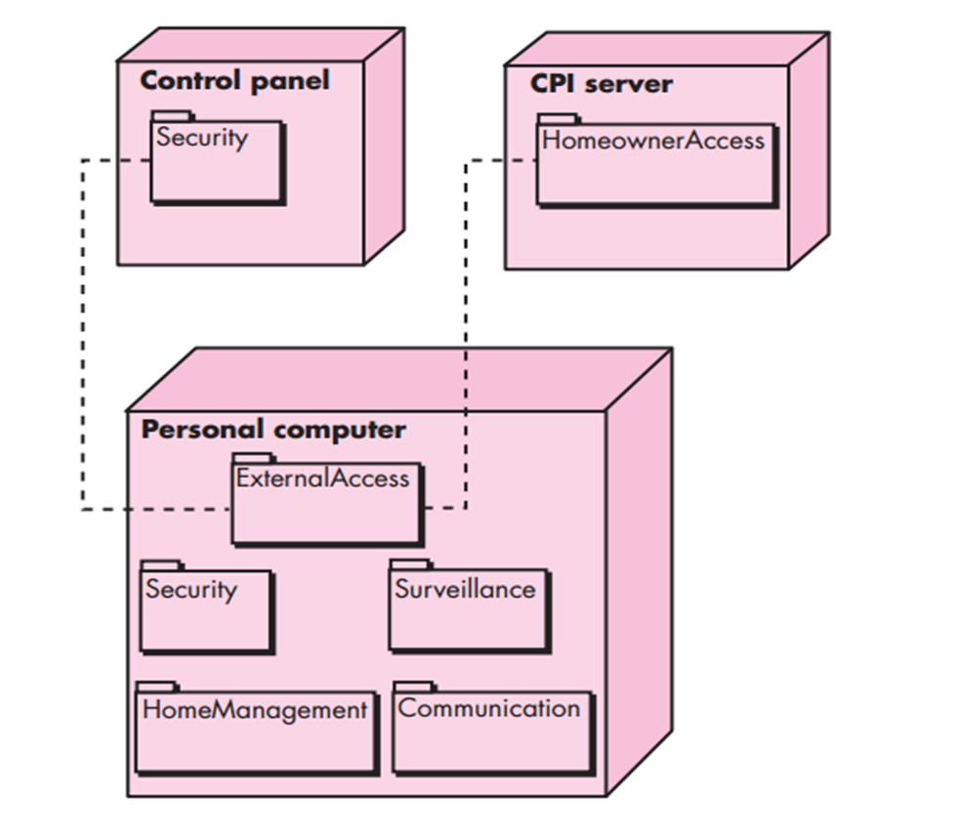
A UML deployment diagram

Slide 45
Chapter 09
“ARCHITECTURAL DESIGN”

Slide 46
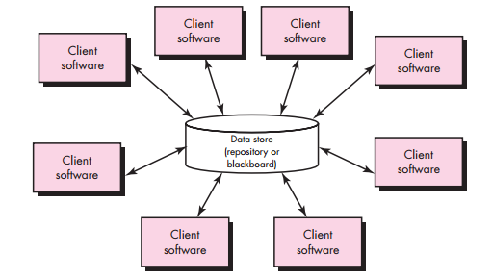
Data-centered architecture

Slide 47
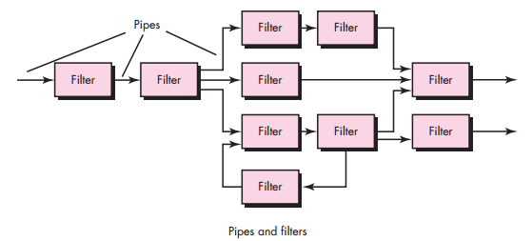
Data-flow architecture

Slide 48
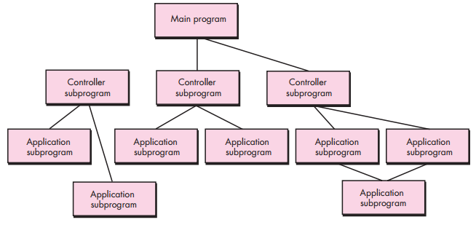
Main program/subprogram architecture

Slide 49
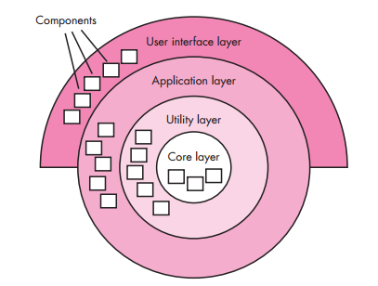
Layered architecture

Slide 50
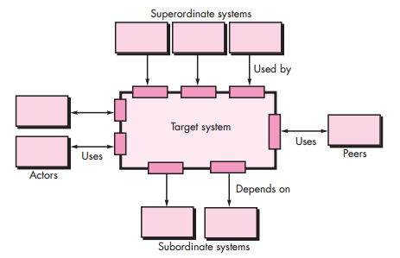
Architectural context diagram

Slide 51
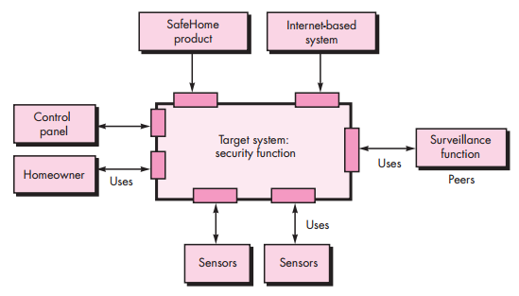
Architectural context diagram for the SafeHome security function

Slide 52
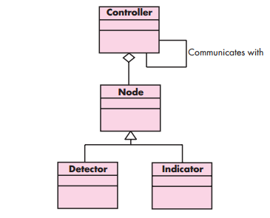
UML relationships for SafeHome security function archetypes

Slide 53
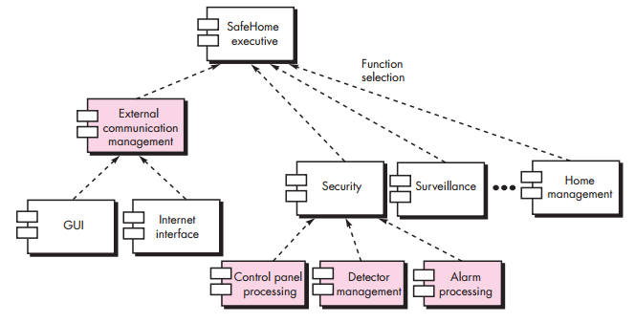
Overall architectural structure for SafeHome with top-level components

Slide 54
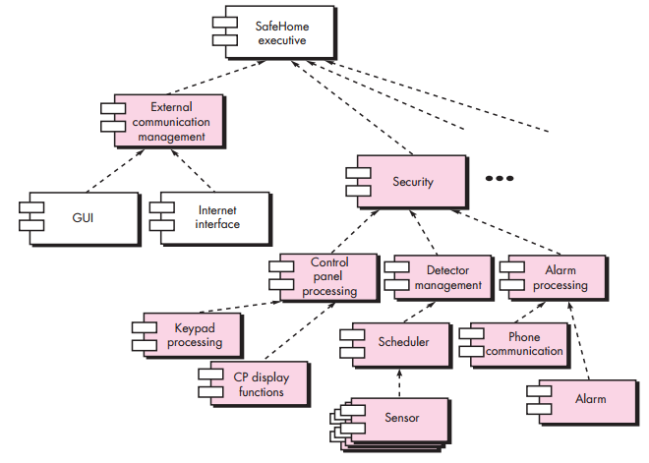
An instantiation of the security function with component elaboration

Slide 55
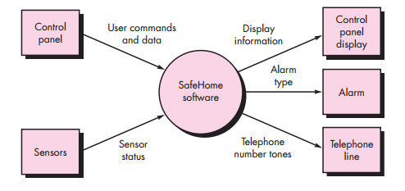
Context-level DFD for the SafeHome security function

Slide 56
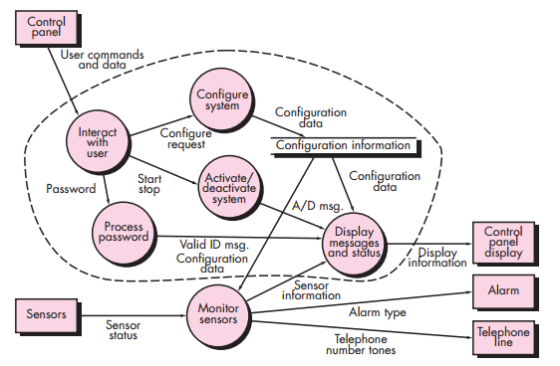
Level 1 DFD for the SafeHome security function

Slide 57
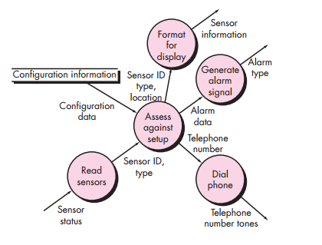
Level 2 DFD that refines the monitor sensors transform

Slide 58

Level 3 DFD for monitor sensors with flow boundaries

Slide 59

First-level factoring for monitor sensors

Slide 60

Second-level factoring for monitor sensors

Slide 61

First-iteration structure for monitor sensors

Slide 62

Refined program structure for monitor sensors

Slide 63
Chapter 10
“COMPONENT-LEVEL DESIGN”

Slide 64

Elaboration of a design component

Slide 65

Structure chart for a traditional system

Slide 66

Component-level design for ComputePageCost

Slide 67

Following the OCP

Slide 68

Layer cohesion

Slide 69

Collaboration diagram with messaging

Slide 70

Refactoring interfaces and class definitions for PrintJob

Slide 71

UML activity diagram for computePaperCost()

Slide 72

Statechart fragment for PrintJob class

Slide 73

Flowchart constructs

Slide 74

Decision table nomenclature

Slide 75
Chapter 11
“USER INTERFACE DESIGN”

Slide 76

The user interface design process

Slide 77

Swimlane diagram for prescription refill function

Slide 78

Preliminary screen layout

Slide 79

Mapping user objectives into interface actions

Slide 80

The interface design evaluation cycle

Slide 81
Chapter 12
“PATTERN-BASED DESIGN”

Slide 82

Pattern-based design in context

Slide 83

A pattern organizing table

Slide 84
Chapter 13
“WEBAPP DESIGN”

Slide 85

Quality requirements tree

Slide 86

A design pyramid for WebApps

Slide 87

Design representation of content objects

Slide 88

Hierarchical structure

Slide 89

Grid Structure

Slide 90

Hierarchical structure

Slide 91

Network structure

Slide 92

The MVC Architecture

Slide 93

Creating an NSU

Slide 94

Summary of the OOHDM method.

Slide 95

Partial conceptual schema for SafeHomeAssured.com

Slide 96
THE END
Thanks To Respected SIR “HUSSAIN SALEEM”

